Slide 1
Data Structures
Chapter 06

Slide 2
Data Structures- Chapter 6
Stacks
A stack is a list of elements in which an element may be inserted or deleted only at one end, called the top of the stack.
This means that elements are removed from a stack in the reverse order of that in which they were inserted into the stack.
Two basic operations associated with stacks:
“Push” is the term used to insert an element into a stack.
“Pop” is the term used to delete an element from a stack.

Slide 3
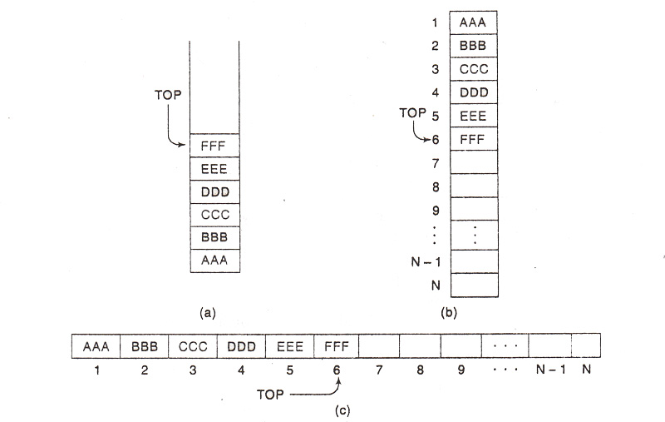
Data Structures- Chapter 6
Diagrams of Stacks

Slide 4
Data Structures- Chapter 6
Procedure 6.1: Write a procedure that pushes an ITEM onto a stack.
PUSH (STACK, TOP, MAXSTK, ITEM)
This procedure pushes an ITEM onto a stack.
1. If TOP = MAXSTK, then: Print: OVERFLOW and Return.
2. Set TOP = TOP + 1.
3. Set STACK[TOP] = ITEM.
4. Return.

Slide 5
Data Structures- Chapter 6
Procedure 6.2: Write a procedure that deletes the top element of a stack.
POP (STACK, TOP, ITEM)
This procedure deletes the top element of STACK and assigns it to the variable ITEM.
1. If TOP = 0, then: Print: UNDERFLOW, and Return.
2. Set ITEM = STACK[TOP].
3. Set TOP = TOP – 1.
4. Return.

Slide 6
Data Structures- Chapter 6
ARITHMETIC EXPRESSIONS; POLISH NOTATION
Infix notation: The operator symbol is placed between its two operands. Example: A+B, A-B, A*B, A/B
Prefix notation: The operator symbol is placed before its two operands. Example: +AB, -AB, *AB, /AB
This notation is also known as Polish notation, named after the Polish mathematician Jan Lukasiewicz.
The fundamental property of Polish notation is that the order in which the operations are to be performed is completely determined by the positions of the operators and operands in the expression. Accordingly, one never needs parentheses when writing expressions in Polish notation.

Slide 7
Data Structures- Chapter 6
ARITHMETIC EXPRESSIONS; POLISH NOTATION
Postfix notation: The operator symbol is placed after its two operands. Example: AB+, AB-, AB*, AB/
This notation is also known as Reverse Polish notation.
One never needs parentheses to determine the order of the operations in any arithmetic expression written in reverse Polish notation.
The computer usually evaluates an arithmetic expression written in infix notation in two steps. First, it converts the expression to postfix notation, and then it evaluates the postfix expression. In each step, the stack is the main tool that is used to accomplish the given task.

Slide 8
Data Structures- Chapter 6
Example 6.7: Transform the following arithmetic infix expression Q into its equivalent postfix expression P:
Q: A + (B*C - (D /E ↑ F)*G)*H
Solution:
Push “(” onto stack and then add “)” to the end of Q. Thus, Q becomes
Q: A + ( B * C - ( D / E ↑ F ) * G ) * H )
Start scanning. The following table shows the status of STACK and of the string P as each element of Q is scanned.

Slide 9
Data Structures- Chapter 6
Example 6.7: Transform the following arithmetic infix expression Q into its equivalent postfix expression P:
Q: (A + (B*C - (D /E ↑ F)*G)*H)
Solution:
Symbol Scanned | STACK | Expression, P
A | ( | A
+ | ( + | A
( | ( + ( | A
B | ( + ( | A B
* | ( + ( * | A B
C | ( + ( * | A B C
- | ( + ( - | A B C *
( | ( + ( - ( | A B C *

Slide 10
Data Structures- Chapter 6
Example 6.7: Transform . . . . . postfix expression P:
Q: A + (B*C - (D /E ↑ F)*G)*H)
Symbol Scanned | STACK | Expression, P
D | ( + ( - ( | A B C * D
/ | ( + ( - ( / | A B C * D
E | ( + ( - ( / | A B C * D E
↑ | ( + ( - ( / ↑ | A B C * D E
F | ( + ( - ( / ↑ | A B C * D E F
) | ( + ( - | A B C * D E F ↑ /
* | ( + ( - * | A B C * D E F ↑ /
G | ( + ( - * | A B C * D E F ↑ / G
) | ( + | A B C * D E F ↑ / G * -
* | ( + * | A B C * D E F ↑ / G * -
H | ( + * | A B C * D E F ↑ / G * - H
) |  | A B C * D E F ↑ / G * - H * +

Slide 11
Data Structures- Chapter 6
Solved Problem 6.10: Transform the following arithmetic infix expression Q into its equivalent postfix expression P:
Q: ((A + B)*D) ↑ (E-F)
Solution:
Push “(” onto stack and then add “)” to the end of Q. Thus, Q becomes
Q: ((A + B) * D) ↑ (E-F) )
Start scanning. The following table shows the status of STACK and of the string P as each element of Q is scanned.

Slide 12
Data Structures- Chapter 6
Solved Problem 6.10: Transform . . . postfix expression P:
Q: ((A + B)*D) ↑ (E-F))
Symbol Scanned | STACK | Expression, P
( | ( (
( | ( ( (
A | ( ( ( | A
+ | ( ( ( + | A
B | ( ( ( + | A B
) | ( ( | A B +
* | ( ( * | A B +
D | ( ( * | A B + D
) | ( | A B + D *
↑ | ( ↑ | A B + D *
( | ( ↑ ( | A B + D *
E | ( ↑ ( | A B + D * E
- | ( ↑ ( - | A B + D * E
F | ( ↑ ( - | A B + D * E F
) | ( ↑ | A B + D * E F -
) |  | A B + D * E F - ↑

Slide 13
Data Structures- Chapter 6
Algorithm 6.6: Write an algorithm that transforms the infix expression into its equivalent postfix expression.
POLISH (Q, P)
Suppose Q is an arithmetic expression written in infix notation. This algorithm finds the equivalent postfix expression P.
1. Push “(” onto STACK and add “)” to the end of Q.
2. Scan Q from left to right and repeat steps 3 to 6 for each element of Q until the STACK is empty.
3. If an operand is encountered, add it to P.
4. If a left parenthesis is encountered, push it onto STACK.

Slide 14
Data Structures- Chapter 6
Algorithm 6.6: Write an algorithm that transforms the infix expression into its equivalent postfix expression.
5. If an operator is encountered, then
(a) Repeatedly pop from STACK and add to P each
operator (on the top of STACK) which has the same
precedence as or higher precedence than .
(b) Add to STACK.
[End of if structure]
6. If a right parenthesis is encountered, then
(a) Repeatedly pop from STACK and add to P each
operator (on the top of STACK) until a left parenthesis
is encountered.
(b) Remove the left parenthesis.
[End of if structure]
[End of Step 2 loop]
7. Exit.

Slide 15
Data Structures- Chapter 6
Example 6.6: Find the value of the following arithmetic expression P written in postfix notation:
P: 5, 6, 2, +, *, 12, 4, /, -
Solution:
- First we add a sentinel right parenthesis at the end of P:
- Start scanning from left to right. The following table shows the contents of STACK as each element of P is scanned. The final number in STACK, 37, which is assigned to VALUE when the sentinel ")" is scanned, is the value of P.
P: | 5, | 6, | 2, | +, | *, | 12, | 4, | /, | -, | )
 | (1) | (2) | (3) | (4) | (5) | (6) | (7) | (8) | (9) | (10)

Slide 16
Data Structures- Chapter 6
Example 6.6: Find the value of the following arithmetic expression P written in postfix notation:
Solution:
P: | 5, | 6, | 2, | +, | *, | 12, | 4, | /, | -, | )
 | (1) | (2) | (3) | (4) | (5) | (6) | (7) | (8) | (9) | (10)
Symbol Scanned | STACK
5 6 2 + * 12 4 / - ) | 5 5, 6 5, 6, 2 5, 8 40 40, 12 40, 12, 4 40, 3 37

Slide 17
Data Structures- Chapter 6
Algorithm 6.5: Write an algorithm that finds the value of an arithmetic expression written in postfix notation.
This algorithm finds the VALUE of an arithmetic expression P written in postfix notation.
1. Add a right parenthesis “)” at the end of P.
2. Scan P from left to right and repeat Steps 3 and 4 for each element of P until the sentinel ")" is encountered.
3. If an operand is encountered, put it on STACK.
4. If an operator is encountered, then:
a) Remove the two top elements of STACK, where A is the top
element and B is the next-to-top element.
b) Evaluate B A.
c) Place the result of (b) back on STACK.
[End of If structure]
[End of Step 2 loop.]
5. Set VALUE equal to the top element on STACK.
6. Exit.

